Slide 1
Spring Cloud and
Spring Cloud Services
February 2019

Slide 2


From Monolith to Microservices!
Improved Productivity and Speed
Development can occur in parallel, no waiting for other microservices to finish
High Scalability and Flexibility
Adding and scaling microservices becomes painless since they are decoupled
Easier to Build and Maintain Apps
Deployed and managed independently
Problems do not influence the entire system
Organized Around Business Capabilities
Built around business capabilities, not technologies
Ability to be reused in different business channels

Slide 3

Cloud Native Microservices Challenges
Free!!
Moving to a cloud-native microservices architecture comes with its own set of challenges...
Notes:
Although microservices provide many benefits, there’s no free lunch.
The sheer number of services that are created present their own set of challenges. A platform such as PCF is needed to monitor and manage the services

Slide 4
Cloud Native Microservices Challenges
Service discovery
Configuration management
Managing failure
Service tracing
Notes:
Developers face other challenges for their microservice applications

Slide 5
Service Discovery
How can one service find the endpoint of the other service it wants to call?

Slide 6
Configuration Management
How to manage the configurations for a large number of services across multiple environments?
Dev
QA
Prod

Slide 7
How to deal with Cascading Failures?
X
Notes:
We would like to have a mechanism for preventing cascading failures of microservices. Given that communications are performed over the network, how can we make sure that a network glitch doesn’t bring down our entire application?

Slide 8
How can we debug and trace microservices?
Notes:
With a large number of microservices chained together, how can we trace requests for debugging and performance optimization purposes? If the end client is experiencing slow response times, how can we zero in on the particular microservices that are causing an issue?

Slide 9

Netflix OSS
Netflix needed to be faster to win / disrupt
Pioneer and vocal proponent of microservices – the key to their speed and success
Netflix OSS supplies parts, but it’s not a solution
Notes:
Have to be able to scale in response to surges, add new features rapidly. Can’t go down for maintenance/upgrades.
NetFlix, an undisputed business & technology leader
34% of peak N. American internet traffic from 6-9pm
If speed was why they won, microservices was how
They pioneered / began to popularize micro service concept
All they had was Amazon EC2 back then
They had to invent a distributed platform, cloud native platform with PaaS – like features
They had to invent microservice infrastructure at the application level
All before writing one line of code that relates to the application we know as Netflix

Slide 10







Spring Cloud Netflix
Ribbon
Archaius
Hystrix
Feign
Zuul
Client
Eureka
Turbine
Server
Notes:
Diving into Spring Cloud Netflix, for example, we see here some of the Netflix OSS projects for which Spring Cloud provides integrations.
Ribbon, the Netflix client-side load balancer, and Eureka, the Netflix discovery server, can be used together as we saw earlier where the client side load balancer loads routing information from the discovery server and applies its own load balancing rules.
Netflix Hystrix is an implementation of a circuit breaker. With Spring annotations, we can use AOP to add fallback commands to methods. We can also automatically report failures and metrics ass streams, in accordance with 12-factor app principles, and Netflix Turbine can collect these streams and provide an aggregated visualization into the state of all circuit breakers in the system.
------------------------------
Auxiliary notes:
Ribbon: A client load balancer. Ribbon loads routing info from Eureka. It has several implementations of load balancing rules. Ribbon is used internally by Feign
Feign: A declarative REST client. Allows annotation of interface to be mapped to endpoints. When combined with Ribbon it adds load balancing capabilities to the client interface
Hystrix: Circuit breaker patter implementation. Via spring annotations add commands to methods using AOP. Protects clients from failures and reports metrics via a stream of HTTP events
Zuul: A set of HTTP filters do add routing, security. On spring its used to create a CORS filter for UI apps to be able to access external services
Archaius: Dynamic configuration management. Used with Spring’s config server to allow dynamic properties loading

Slide 11

Spring Cloud
Easy developer access to a curated selection of open source cloud infrastructure libraries
Encapsulates access to underlying libraries, allowing pluggable implementations.
Additional capabilities include Cloud Connectors
Brings the Spring philosophy of convention over configuration, opinionated defaults, and developer simplicity
Notes:
The Spring Cloud project has been created to facilitate and ease the development Java applications in cloud native environments.

Slide 12


Spring Cloud
Spring Cloud
Service registration and discovery
API gateway
Client-side load balancing
Git-backed configuration store
Circuit breakers
OAuth 2.0 security support
Distributed tracing
Event-driven microservices
Orchestrated data pipelines
+
=

Slide 13
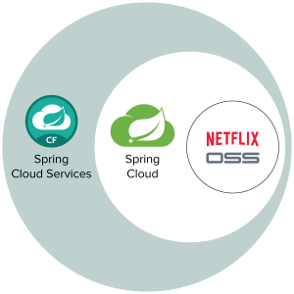



Spring Cloud Services
Pivotal has bundled a number of these OSS projects into Spring Cloud Services for PCF
Service Registry
Config Server
Circuit Breaker

Slide 14
Spring Cloud Services
Service Registration and Discovery, using Netflix OSS Eureka
Service Registry
Centralized repository for application properties
Config Server
Prevent cascading invocation failures by providing alternative local methods
Circuit Breaker

Slide 15

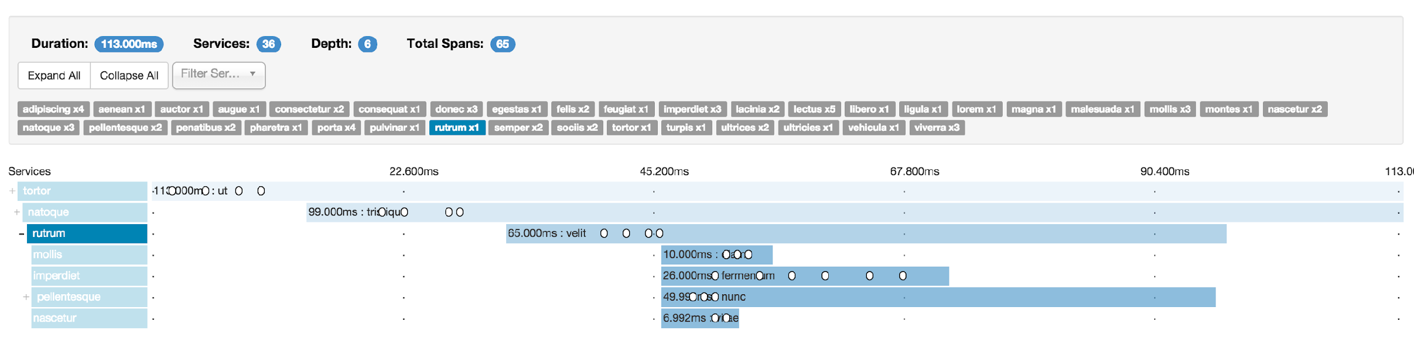
Spring Cloud
Distributed tracing of microservices invocations, not yet part of the Spring Cloud Services suite
Spring Cloud Sleuth

Slide 16
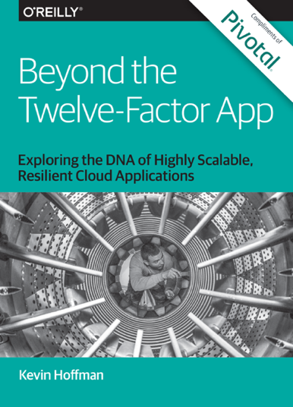

If you think this is cool...
Check these out!
https://content.pivotal.io/ebooks

Slide 17
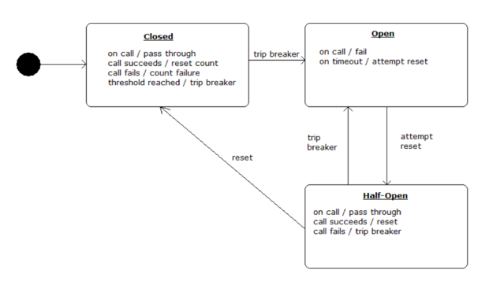
Dealing with Failures
Stop sending requests to a failing service (allowing time to recover)
Fail gracefully by implementing fall-back behavior
Open Circuit = Failed method
Closed Circuit = Successful method

Slide 18
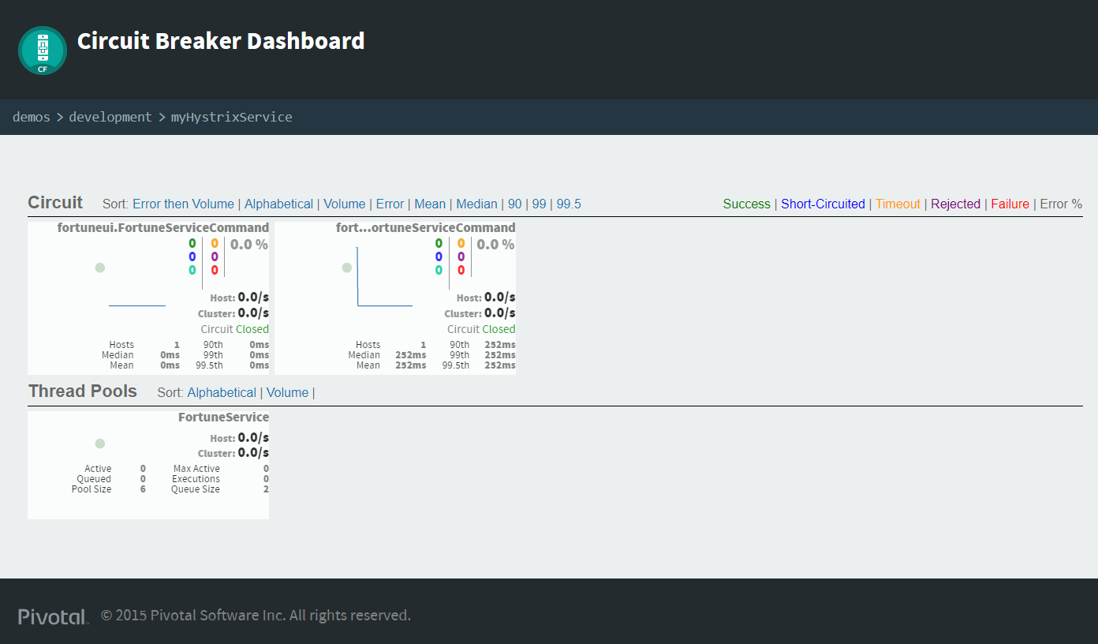
Dealing with Failures
Visibility into Failures Application Wide

Slide 19
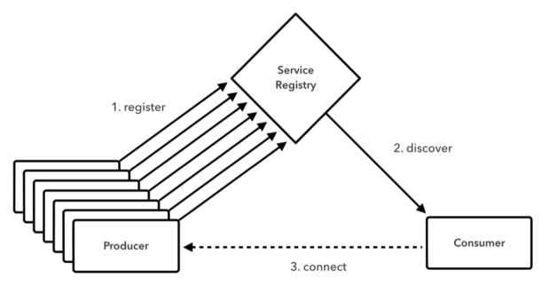
Discovering Services
Use Service IDs, not URLs, to locate services
Client-side or server-side load balancing

Slide 20

Transforming How The World Builds Software
© Copyright 2017 Pivotal Software, Inc. All rights Reserved.

